Slide 1
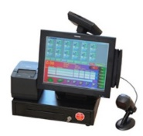
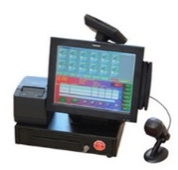
ESB Applications
Oracle Service Bus
DBF
JDBC
POS Data Polling
Sales
Data
Web Service
DB
Adapters
(EDW)
Enterprise Data Warehouse
JDBC
SQL
Staging Tables
JDBC
Pricing/Master Data Process
Pricing/
Master Data
Request Service
DB
Adapters
(Pricing & Master)
JDBC
Pricing Server
(IT12)
SQL DB
SQL
Pricing & Master Tables

